Slide 1

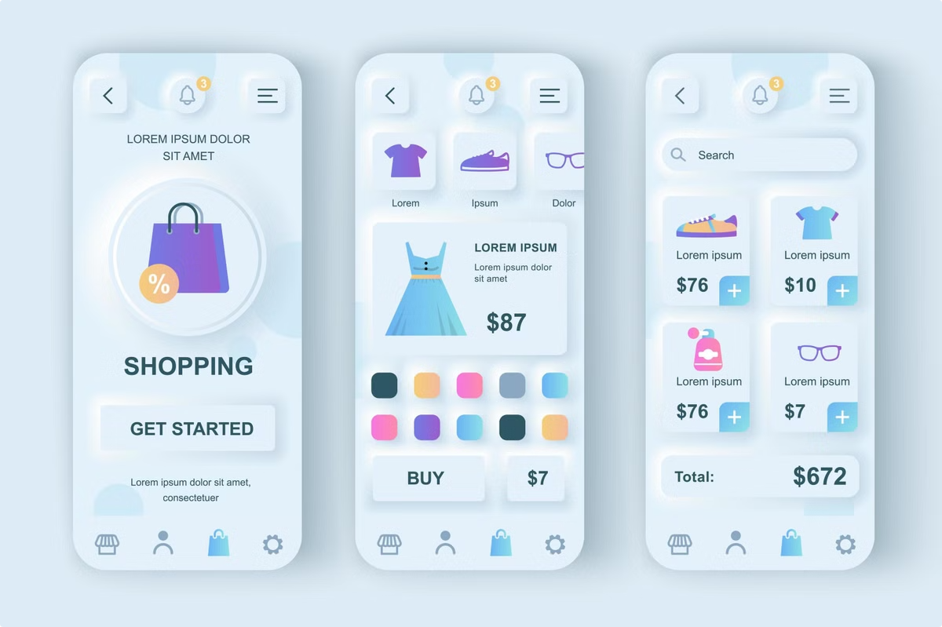
Shopstream: A Data Pipelining-Based Real-Time and Batch Recommendation System
Shopstream is an innovative solution that personalizes the online retail experience by leveraging real-time data processing and machine learning. It utilizes the Instacart Market Basket Analysis dataset to create tailored recommendations for shoppers.

Slide 2


Instacart Market Basket Analysis: Unlocking Retail Insights
Shopping Patterns
Product Affinity
The Instacart dataset provides valuable insights into consumer shopping habits. Analyzing frequent item combinations reveals key patterns that can be leveraged for personalized recommendations.
By understanding which products are frequently purchased together, Shopstream can suggest complementary items to customers, increasing basket size and sales.
Customer Segmentation
The dataset allows for segmentation of customers based on their purchase history, enabling targeted recommendations that cater to specific needs and preferences.

Slide 3
Instacart Market Basket Analysis Dataset: For Batch Processing
About:
Used:
The Instacart Dataset is a publicly available dataset that contains user transactions from an online grocery store. It includes detailed information about user orders, products, and their attributes.
The dataset was used to train a collaborative filtering-based recommendation system using PySpark and ALS.

Slide 4
Objectives
Develop a Scalable Data Pipelining Framework
Implement Real-Time Recommendation Updates
• Goal: To design a robust architecture that integrates various data processing technologies, enabling seamless ingestion and processing of real-time and historical user data.
• Goal: To provide instant, contextually relevant product recommendations based on live user interactions.
Enhance Batch Processing for Model Training:
• Goal: To perform in-depth analytics and retraining of recommendation models using historical data.

Slide 5
Objectives
Integrate Multiple Recommendation Algorithms:
Create a User-Friendly Dashboard for
Monitoring and Analytics:
• Goal: To combine various recommendation techniques to enhance the personalization of suggestions.
• Goal: To develop a dashboard that visualizes key performance metrics of the recommendation system.
Conduct A/B Testing to Evaluate Effectiveness:
• Goal: To assess the performance of the recommendation system and its impact on user engagement and sales.

Slide 6

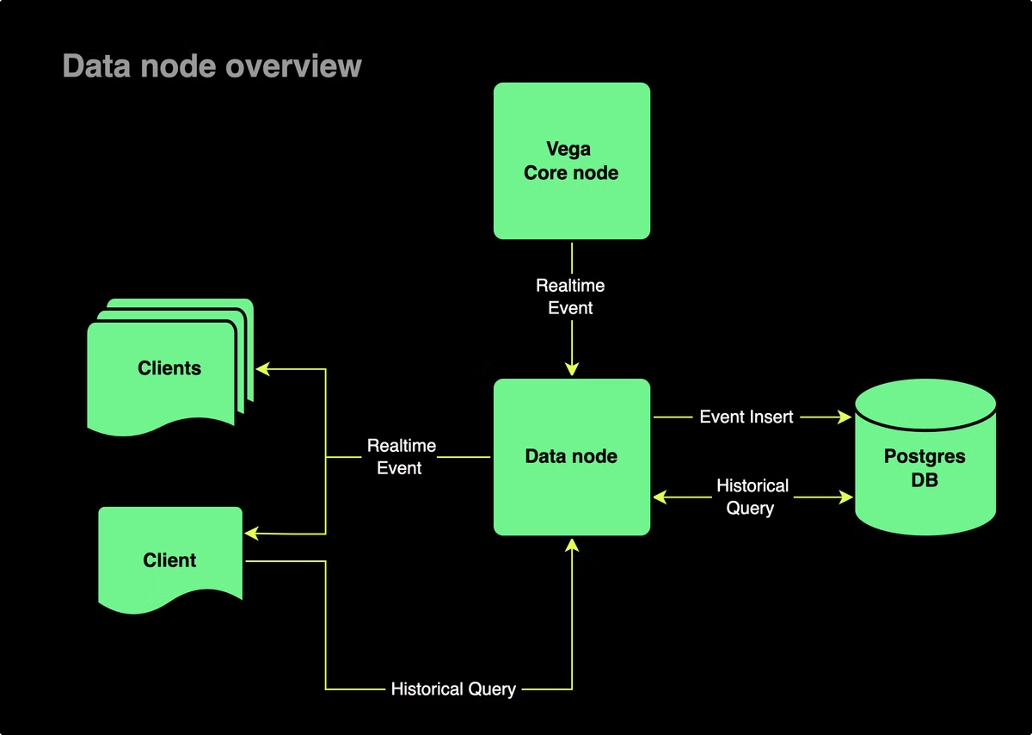



Combining Streaming and Batch Processing for Recommendation Engines
Real-Time Data Processing
Kafka and Spark Streaming process user interactions in real-time, capturing the most up-to-date preferences.
Batch Processing
Apache Spark performs batch processing on historical data, enabling model retraining and updates based on long-term trends.
Recommendation Engine
Combining real-time and batch processing results in a dynamic recommendation engine that adapts to evolving customer behavior.

Slide 7
Kafka and Spark Streaming: Powering Real-Time Data Processing
Kafka
Spark Streaming
Kafka serves as a high-throughput, low-latency messaging system for real-time data ingestion, allowing Shopstream to capture user actions as they happen.
Spark Streaming processes data streams from Kafka, enabling near-instantaneous analysis and response to user behavior, like browsing history or product clicks.

Slide 8

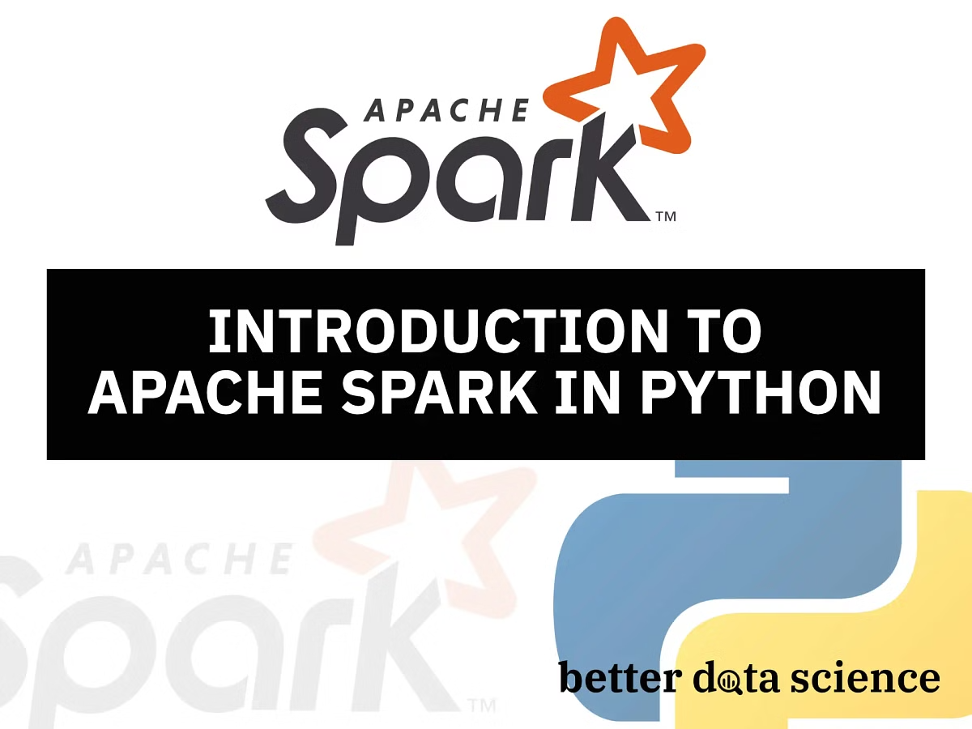
Apache Spark: Enabling Scalable Batch Processing and Model Retraining
1
Model Retraining
2
Scalability
Apache Spark allows for periodic batch processing of historical data to refine recommendation models and ensure they remain accurate over time.
Spark's distributed computing framework handles large datasets and complex algorithms, ensuring scalability as Shopstream grows.
3
Performance
Spark's in-memory processing and optimized algorithms significantly improve the speed and efficiency of batch processing tasks.

Slide 9
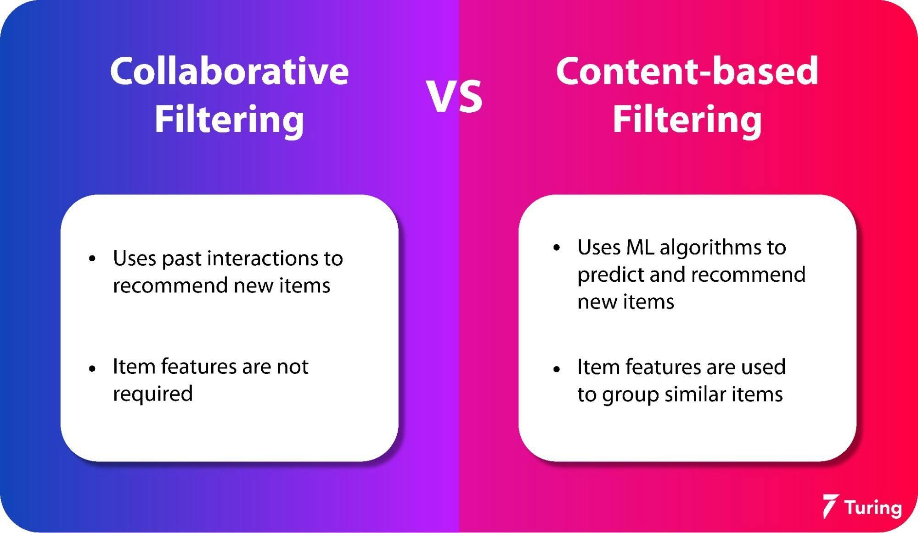

Slide 10

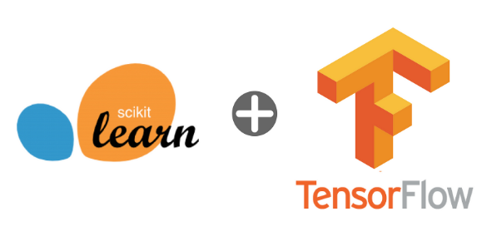
TensorFlow and Scikit-Learn: Collaborative Filtering and Machine Learning
TensorFlow
Scikit-Learn
Deep Learning
Machine Learning
Collaborative Filtering
Regression Models
Advanced Recommendations
Personalized Product Suggestions

Slide 11

Alternating Least Squares (ALS) for Recommendations
ALS is a collaborative filtering algorithm widely used for building recommendation systems. It predicts user preferences by factorizing a sparse user-item interaction matrix into latent factors.
Instacart Dataset → ALS Model Training → Batch Recommendations

Slide 12
Alternating Least Squares (ALS) for Recommendations
Advantages of ALS:
"Handles large-scale sparse matrices efficiently."
"Captures latent patterns in user-product interactions."
"Cold-Start Solutions: Can be enhanced with side information (e.g., demographics, product attributes)."
"Scalable and suitable for distributed systems like Spark."

Slide 13

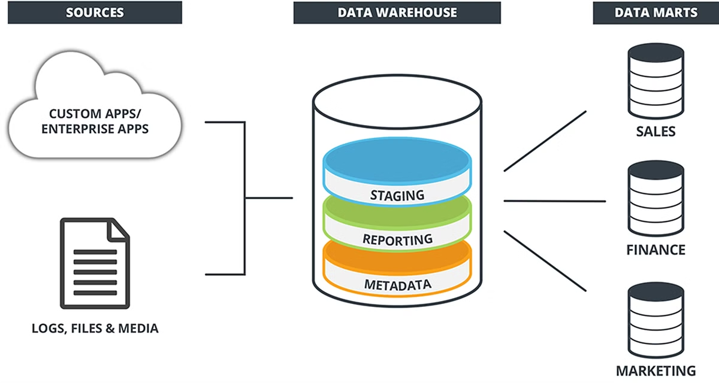


HDFS and MongoDB: Storing and Managing Retail Data
HDFS
MongoDB
Hadoop Distributed File System (HDFS) stores large amounts of historical retail data, providing a robust and scalable storage solution.
MongoDB, a NoSQL database, efficiently stores and retrieves real-time data, enabling quick access to user interactions and purchase history.

Slide 14

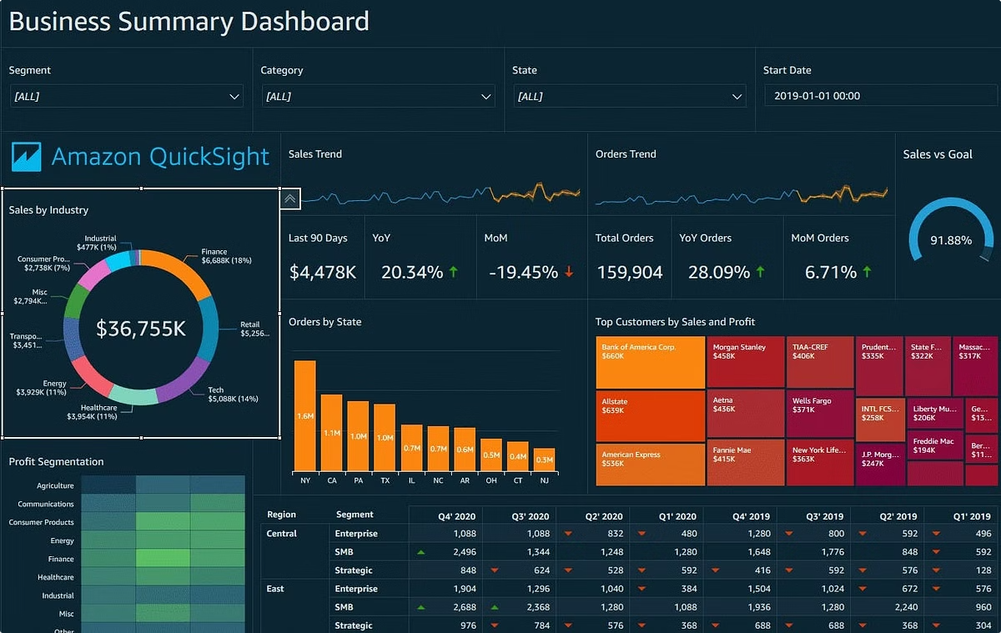
Power BI and Looker: Monitoring Performance and Boosting Sales
1
Data Visualization
Power BI and Looker provide intuitive dashboards that visualize key performance indicators (KPIs) related to Shopstream's effectiveness.
2
Performance Monitoring
The dashboards track metrics like conversion rates, average order value, and customer satisfaction to identify areas for improvement.
3
Sales Optimization
By analyzing data and identifying trends, Shopstream can optimize recommendations, personalize marketing campaigns, and ultimately boost sales.

Slide 15
Methodology:
Data Collection:
Aggregate user interaction data (clicks, views, purchases).
Framework Design:
Employ Apache Kafka for real-time
Ingestion and Apache Spark for batch
data processing.
Algorithm Development:
Implement collaborative, content-based, and hybrid recommendation algorithms.
System Integration:
Real-time updates and batch model retraining for continuous improvements.
Testing:
A/B testing and performance validation to optimize user engagement.

Slide 16


Challenges and Considerations in Building Shopstream
1
Data Privacy
2
Scalability
3
Model Accuracy
Protecting user data and ensuring compliance with privacy regulations is paramount in building Shopstream.
As Shopstream grows, ensuring its infrastructure can handle increasing data volumes and user traffic is a key challenge.
Maintaining the accuracy of recommendation models over time requires continuous monitoring, retraining, and optimization.

Slide 17

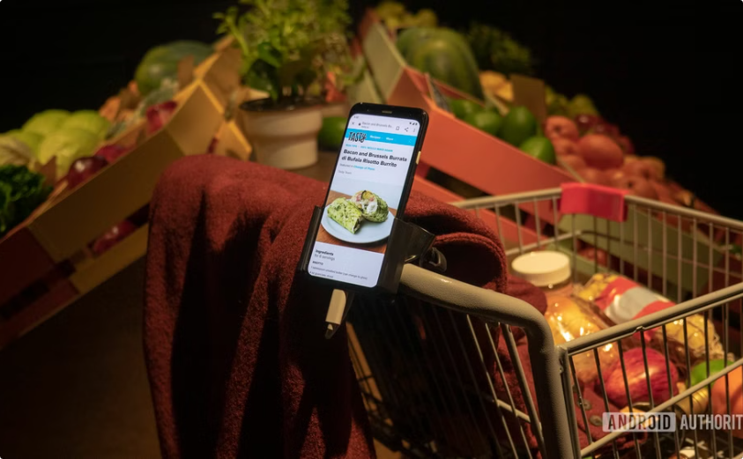
The Future of Personalized Retail Recommendations
AR/VR Integration
Voice-Based Recommendations
Shopstream could integrate with augmented and virtual reality technologies to provide immersive shopping experiences.
Voice assistants could enhance Shopstream's capabilities, allowing users to interact with the system through spoken commands.

Slide 18


